Slide 1
HOSPITALITY ANALYSIS

Slide 2
CONTENTS
INTRODUCTION
OBJECTIVE AND OVERVIEW
DASHBOARD
INSIGHTS
STRATEGIC RECOMMENDATIONS

Slide 3
INTRODUCTION:
The Hospitality Analysis Project leverages Power BI to uncover key insights into the performance and trends within the hospitality sector. This comprehensive analysis focuses on critical metrics such as revenue, occupancy, booking behavior, and pricing strategies to provide actionable insights for informed decision-making.

Slide 4
Project Overview and Objectives:
Objective:
To gain actionable insights into revenue trends, booking behavior, and pricing strategies to drive operational efficiency and customer satisfaction.
Key Focus Areas:
Analyze revenue distribution by city and property to identify growth opportunities.
Evaluate booking patterns by day type and platform for targeted marketing.
Monitor ADR trends to optimize pricing strategies and profitability.

Slide 5
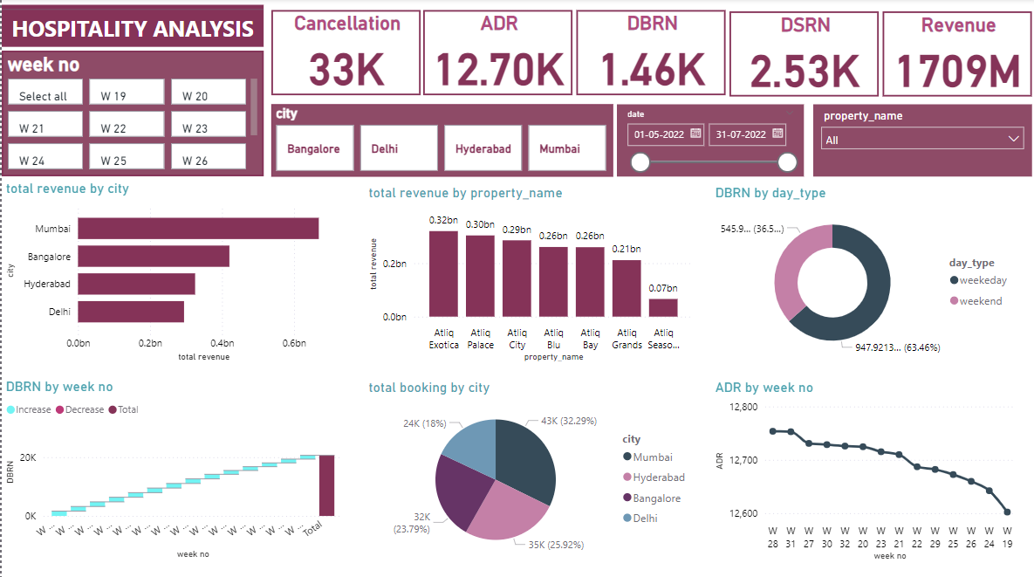
Power Bi dashboard

Slide 6
INSIGHTS

Slide 7
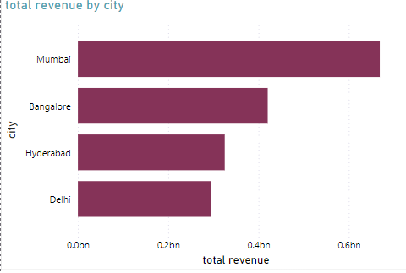
Total Revenue by City
Insight:
Mumbai is the highest revenue-generating city, contributing over 0.6 billion to total revenue. This indicates a significant concentration of customer activity or market dominance in this region.
Bangalore follows with close to 0.4 billion, while Hyderabad and Delhi contribute similar amounts around 0.2 to 0.3 billion.
Mumbai's dominance suggests targeted marketing and operational focus for maximizing ROI. Lower-performing cities like Hyderabad and Delhi may need customized strategies to increase their share.

Slide 8
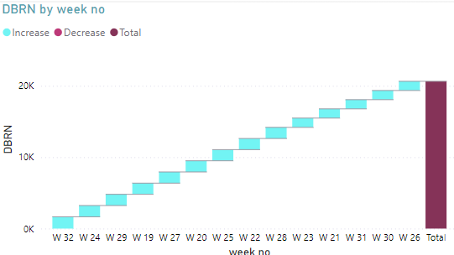
DBRN (Daily Booked Room Nights) by Week Number
Insight:
The trend shows fluctuations in DBRN across weeks, with notable increases during certain weeks.
Peaks indicate high booking demand during specific periods, potentially aligning with holidays, festivals, or promotional campaigns.
This data can be leveraged for forecasting future demand and planning marketing activities during similar high-demand periods.

Slide 9
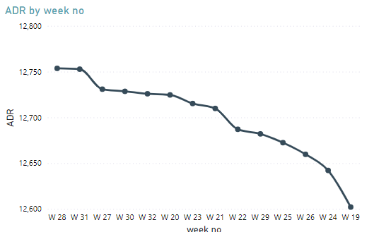
ADR (Average Daily Rate) by Week Number
Insight:
ADR shows a gradual decline over the analyzed weeks, reflecting potential price adjustments or market trends.
A declining ADR suggests a need to evaluate pricing strategies, especially if it is impacting revenue.
Strategies such as bundled offers or targeted discounts could stabilize ADR without compromising occupancy.

Slide 10
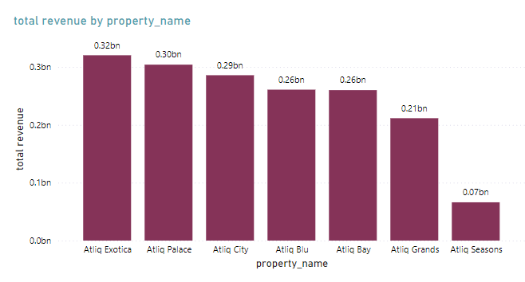
Total Revenue by Property Name
Atliq Exotica is the highest revenue-generating property, contributing 0.32 billion. Its consistent performance highlights its appeal among customers, likely due to premium services, location, or high demand.
Atliq Palace closely follows with 0.30 billion, indicating strong customer traction but slightly behind Atliq Exotica.
Atliq City and Atliq Blu generate nearly equal revenue (around 0.29 billion and 0.26 billion, respectively), showcasing balanced contributions among mid-tier properties.
Atliq Grands and Atliq Bay fall in the lower tier of revenue generators, contributing between 0.21 billion and 0.26 billion, indicating potential for growth with strategic improvements.
Atliq Seasons contributes the least, with only 0.07 billion, suggesting it may have the smallest market share, limited services, or lower customer demand compared to others.

Slide 11
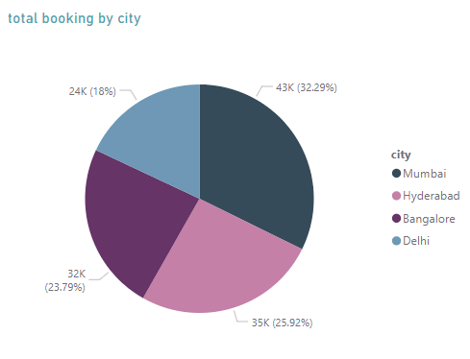
Total Booking by City
Mumbai leads with the highest number of bookings, contributing 43K (32.29%) of the total bookings. This dominance aligns with Mumbai's revenue leadership, highlighting its importance as a key market.
Bangalore follows with 35K bookings (25.92%), showing strong customer activity but trailing Mumbai. Targeted strategies could help close this gap.
Hyderabad records 32K bookings (23.79%), indicating healthy customer engagement but still behind the top two cities. Optimizing services or offerings specific to this city could drive further growth.
Delhi contributes the least, with 24K bookings (18%), reflecting potential market constraints or underperformance compared to the other cities. Focused marketing and customer acquisition strategies could help improve Delhi’s share.

Slide 12
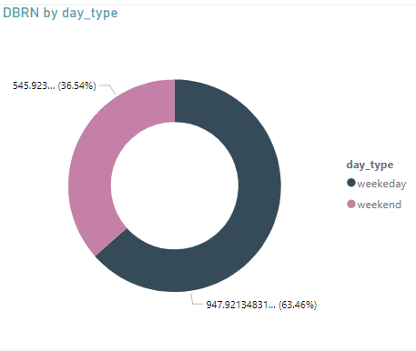
DBRN by Day Type
Insight:
Bookings are split almost equally between weekdays (49.17%) and weekends (50.83%).
This balanced distribution suggests consistent demand across the week, but focused weekday promotions could attract additional bookings during off-peak hours.

Slide 13
Strategic Recommendations:

Slide 14
Enhance Marketing Efforts in Mumbai:
Mumbai leads in both revenue and bookings, showcasing its potential for further investment. Develop premium offerings and targeted marketing campaigns to sustain and maximize its dominance.
Boost Revenue in Underperforming Cities:
Cities like Delhi and Hyderabad show lower performance compared to Mumbai and Bangalore. Implement localized marketing strategies and improve service offerings to capture more market share in these regions.
Stabilize Average Daily Rate (ADR):
The declining ADR trend suggests a need for review. Introduce dynamic pricing strategies, bundled packages, or exclusive discounts to maintain profitability without affecting occupancy.
Focus on Low-Performing Properties:
Properties like Atliq Seasons and Atliq Grands contribute the least to revenue. Enhance their customer appeal by improving services, introducing competitive pricing, and running localized promotions.
Capitalize on High-Demand Periods:
DBRN trends highlight peaks during specific weeks. Align marketing and operational strategies to maximize bookings during these high-demand periods, such as offering festive or holiday discounts.

Slide 15
THANK YOU

